Slide 1

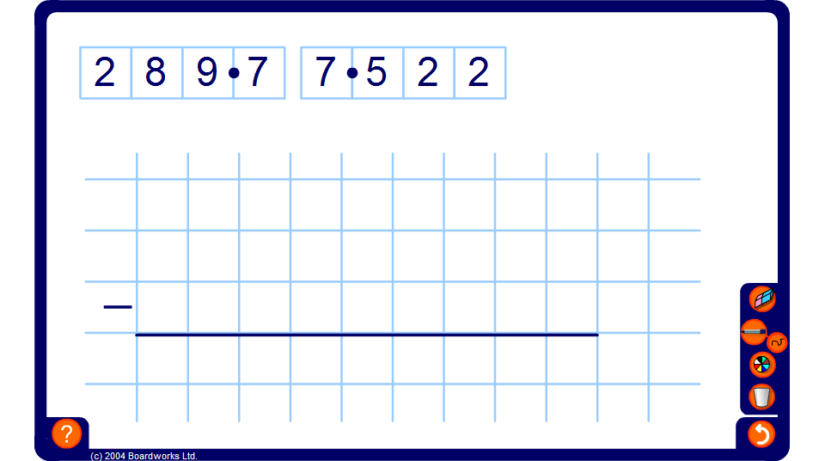


Adding and subtracting decimals
Notes:
Use this activity to demonstrate that the decimal points must be lined up when adding and subtracting decimals.
Use the pen tool to fill in any zero place holders and to complete the calculation.
Ask volunteers to come to the board and complete calculations.

